Slide 1
IMPLEMENTATION:

Slide 2
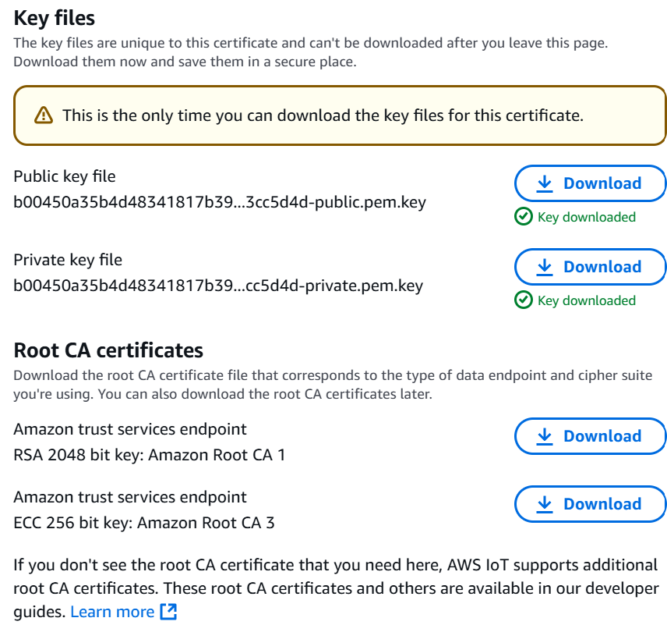
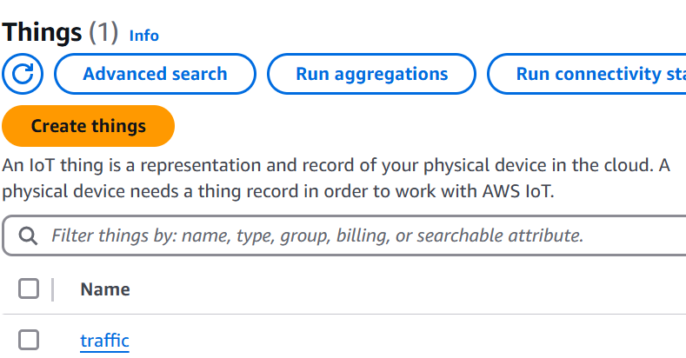
CREATING THING:

Slide 3
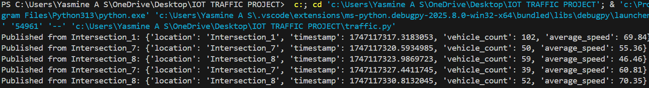
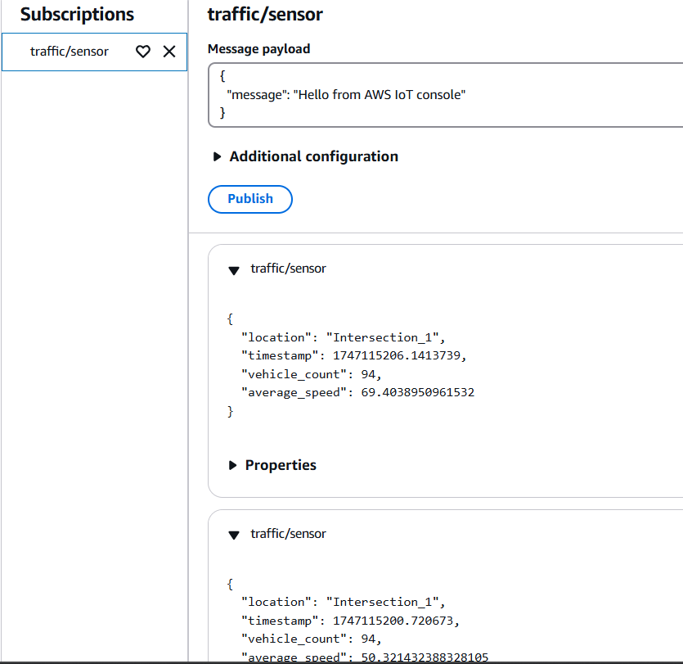
DATA SENDED TO MQTT:

Slide 4
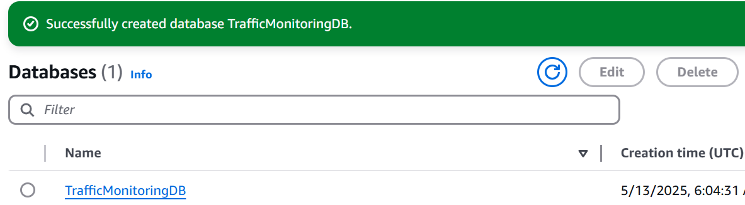
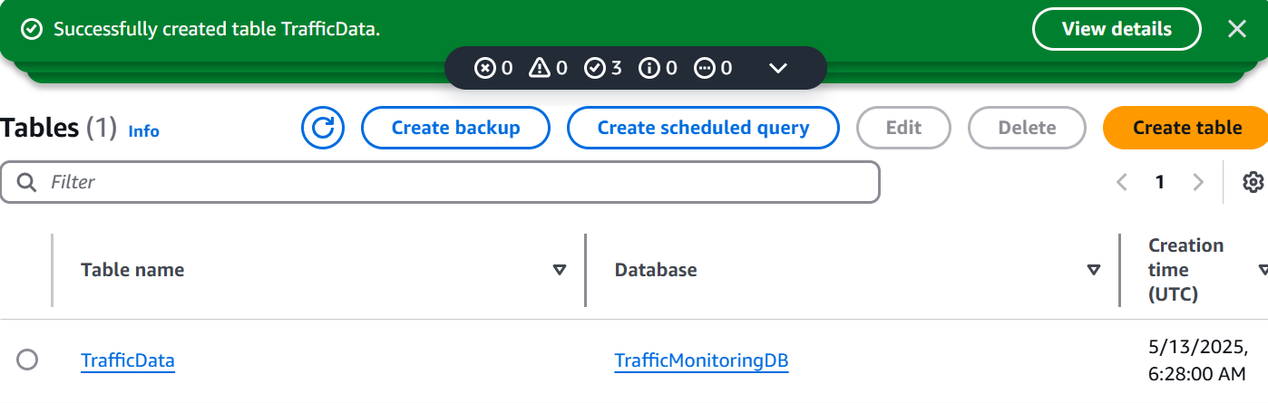
CREATED TIME STREAM:

Slide 5
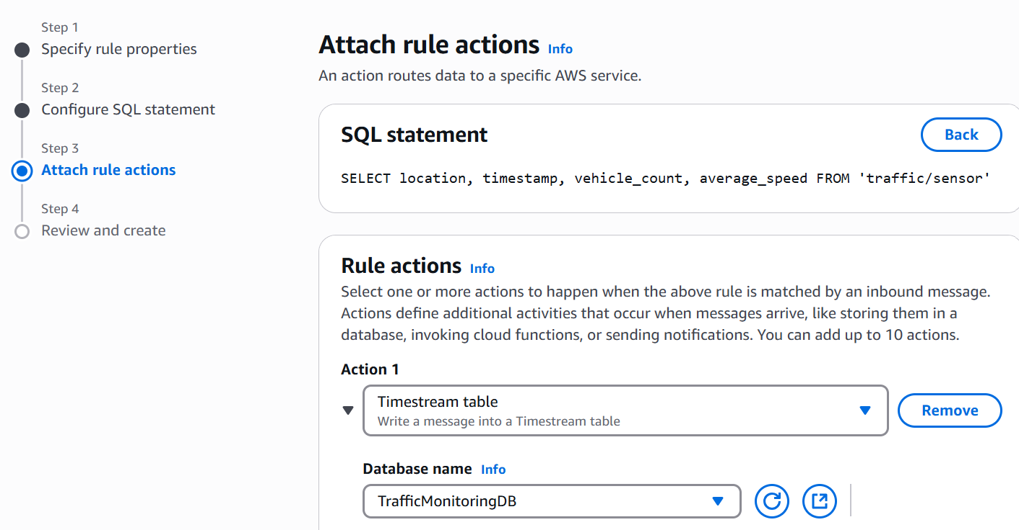
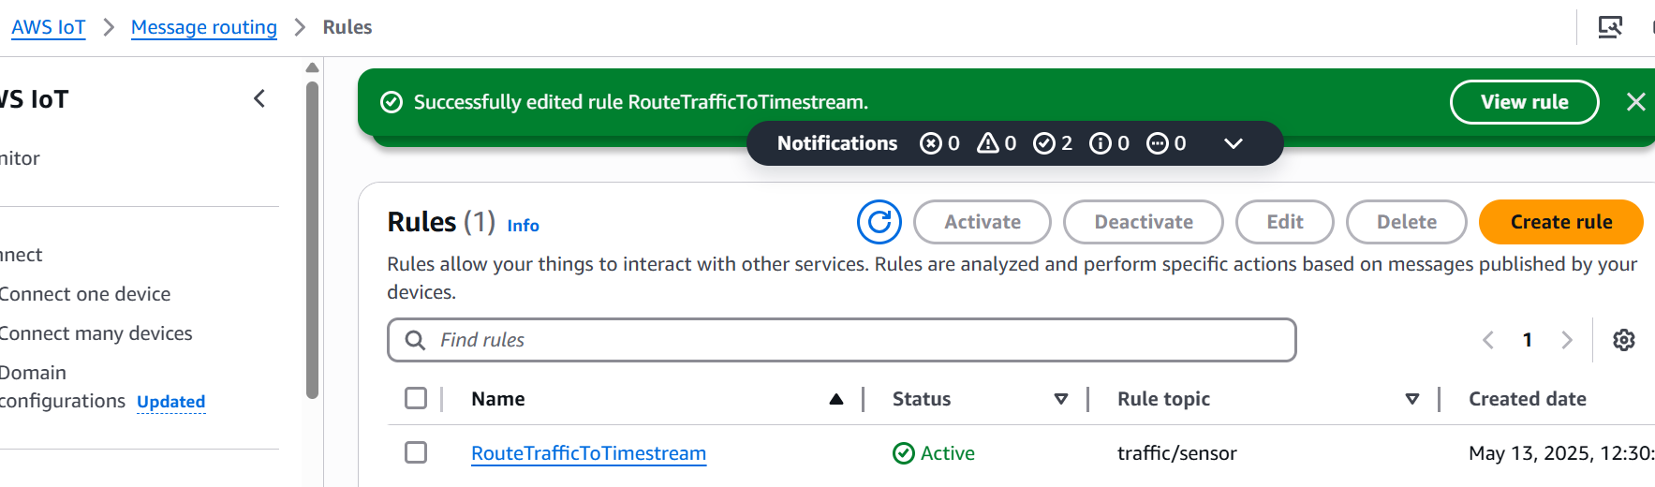
IOT RULE:

Slide 6
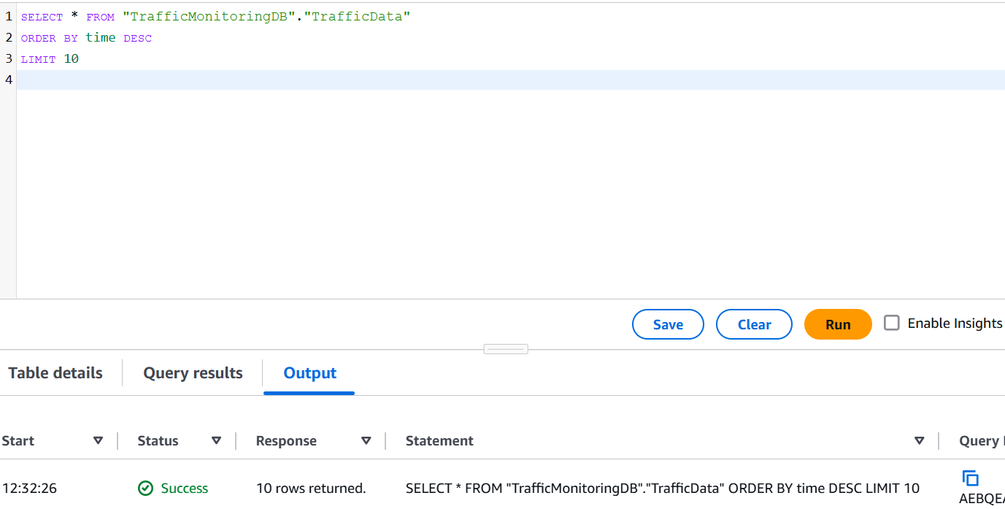
TIME SERIES OUTPUT:

Slide 7
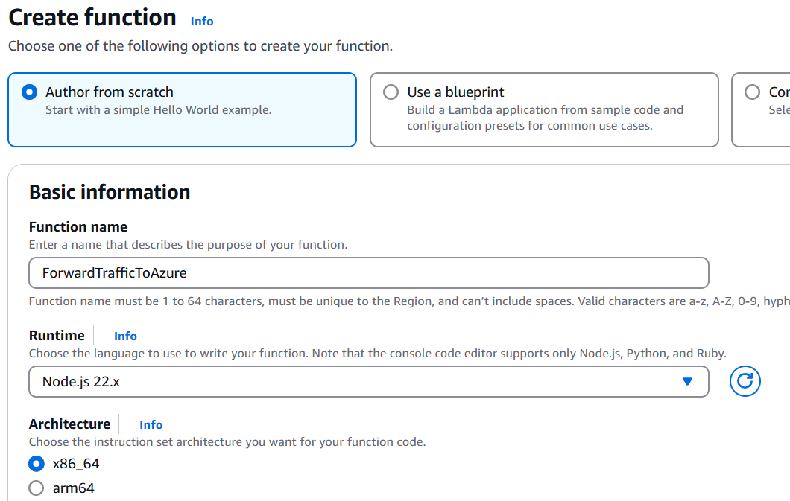
FUNCTION HAS BEEN CREATED:

Slide 8
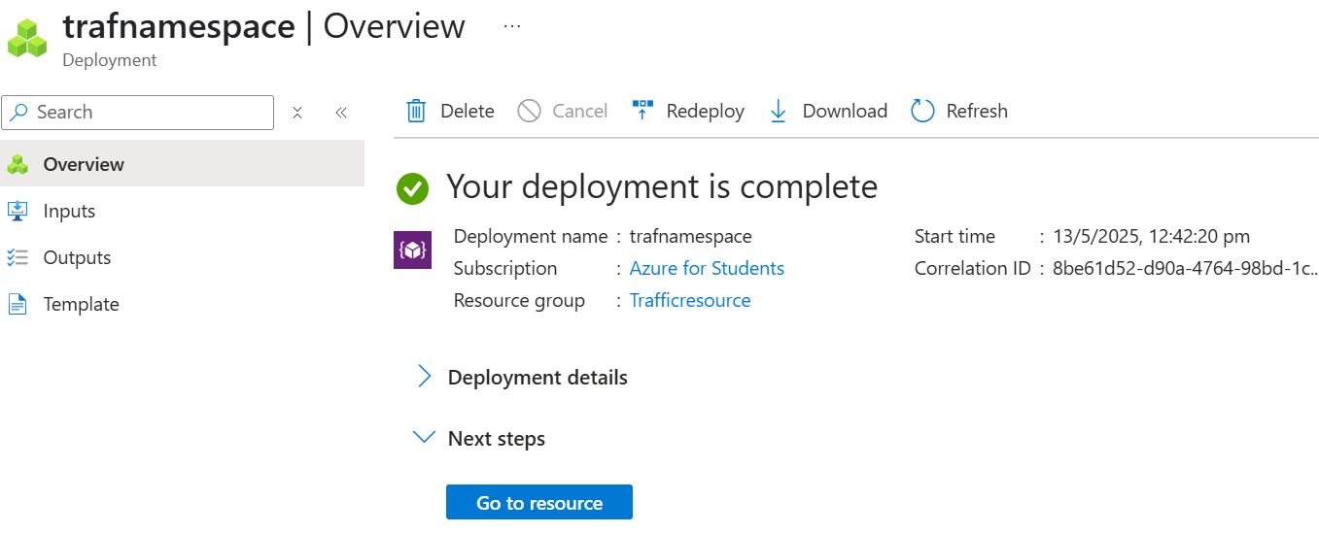
EVENT HUB CREATED:

Slide 9
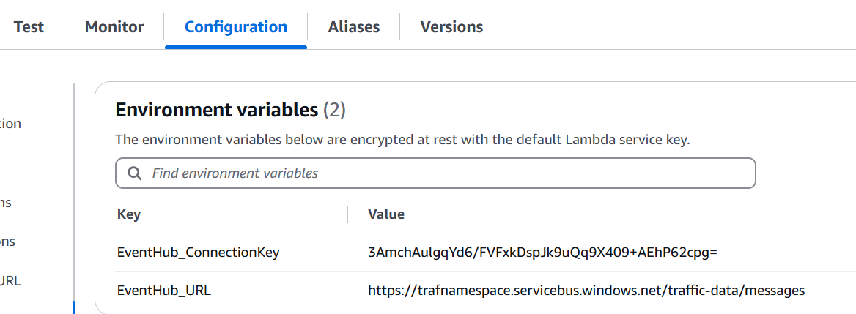
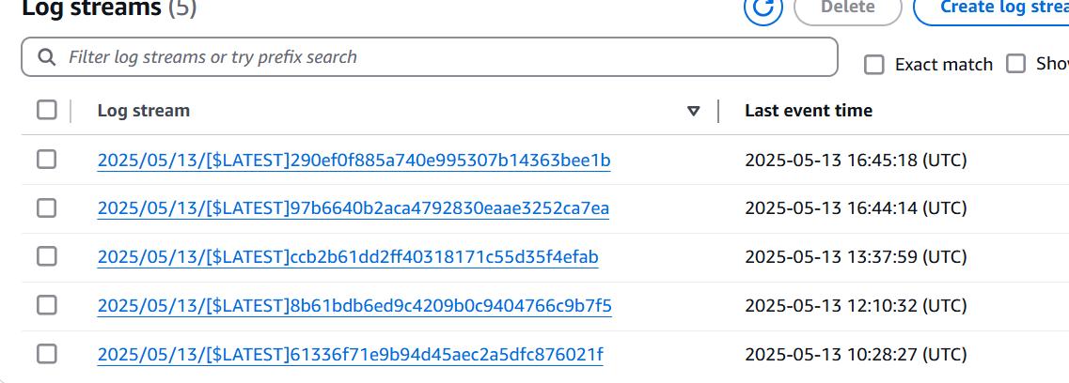
LINKED WITH EVENT HUB FROM LAMBDA

Slide 10
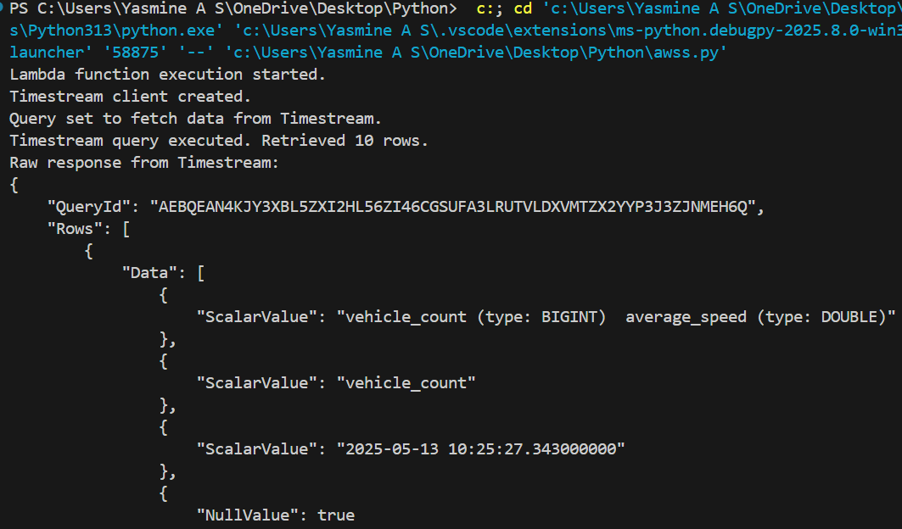
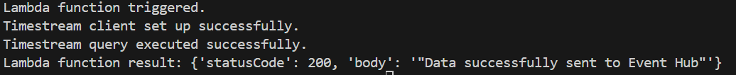
LAMBDA FUNCTION TRIGGERED AND TIME STREAM QUERY SET UP DONE

Slide 11
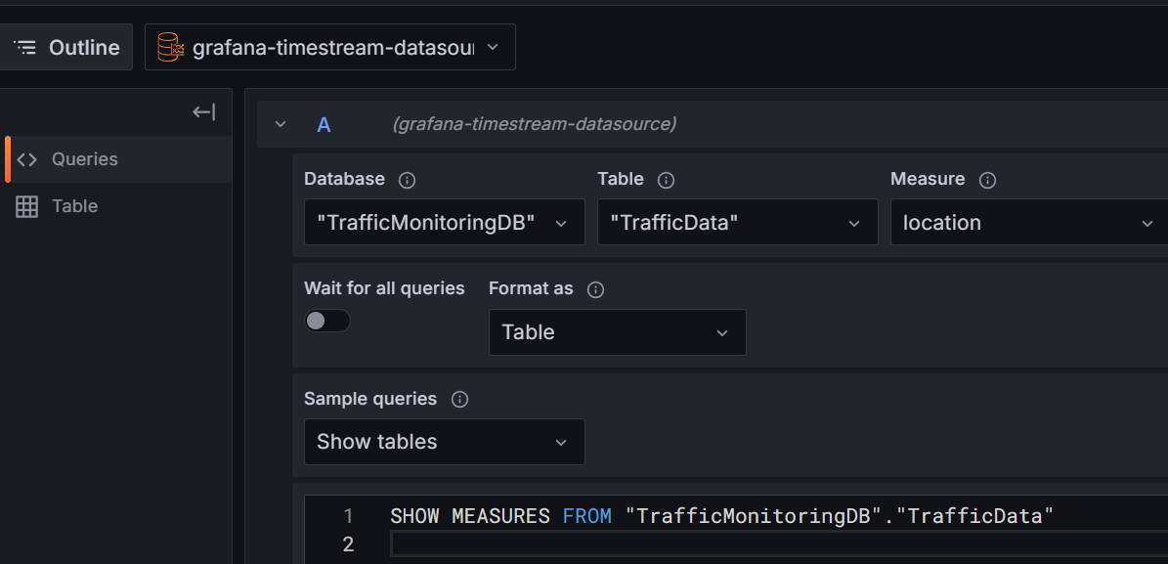
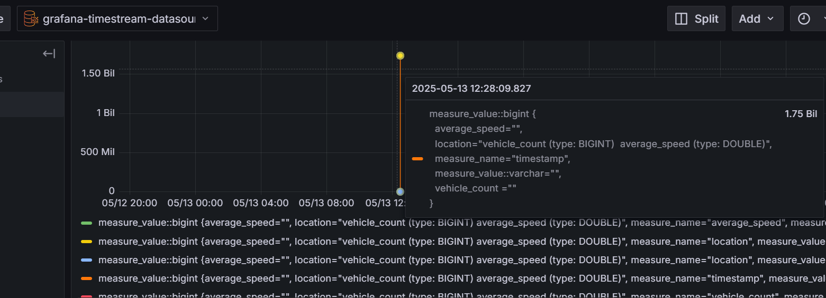
TIME STREAM CONNECTED TO GRAFANA:

Slide 12
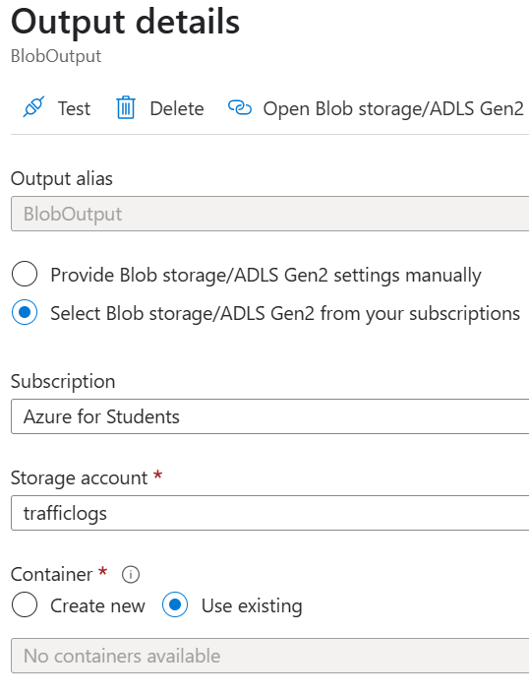
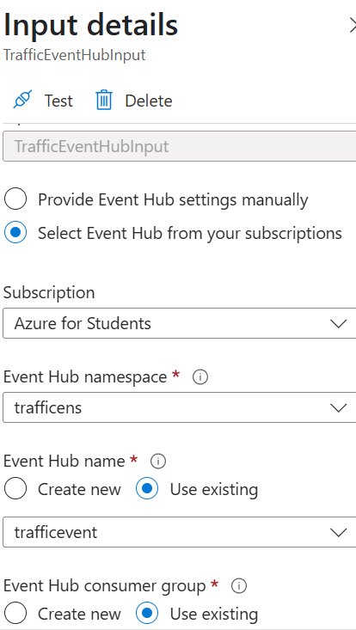
STREAM ANALYTICS:

Slide 13
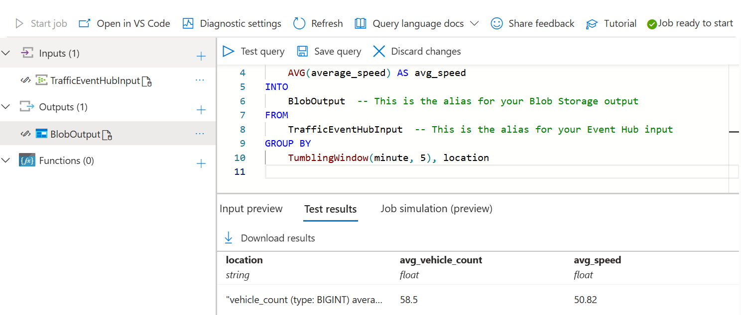
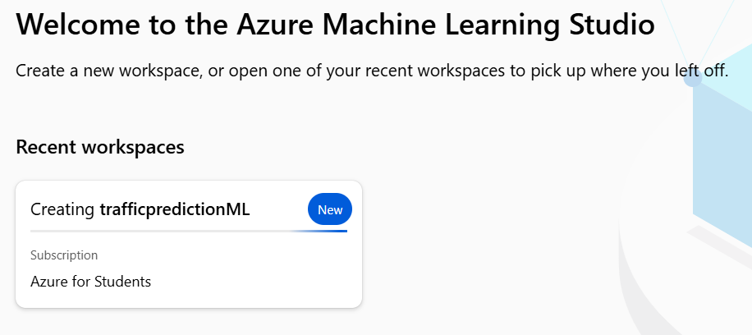
QUERY SETUP:
CREATED AZURE ML:

Slide 14
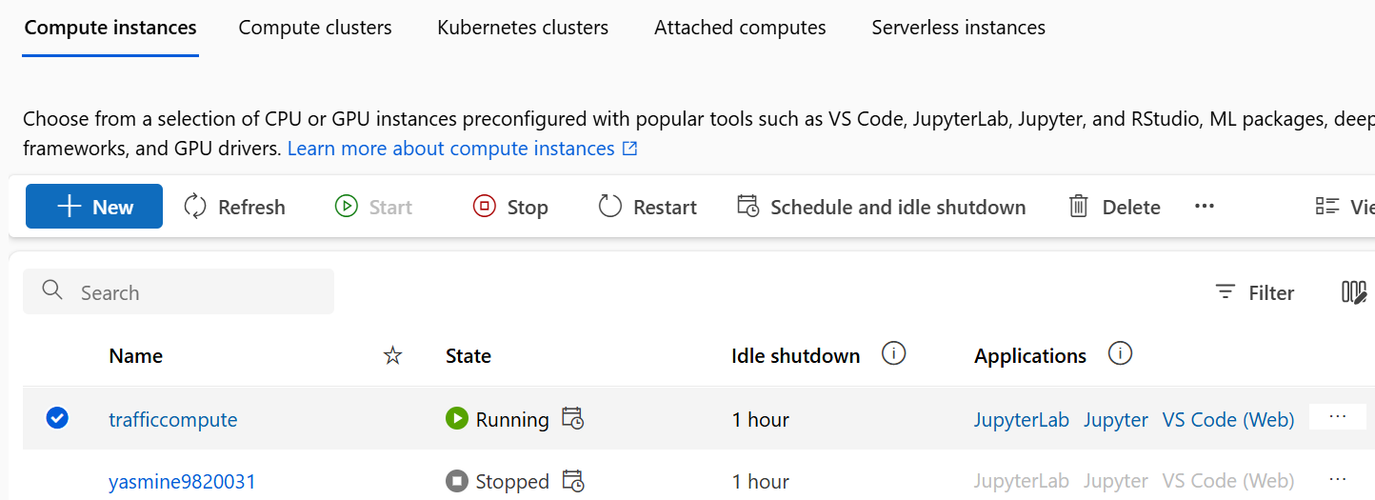
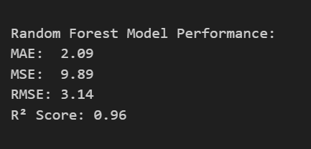
COMPUTE INSTANCE INSIDE THE JUPYTER NOTEBOOK

Slide 15
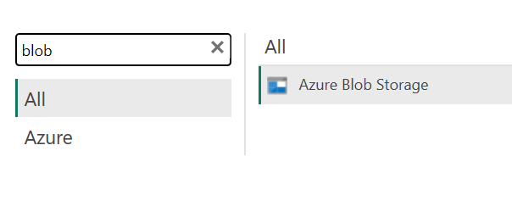
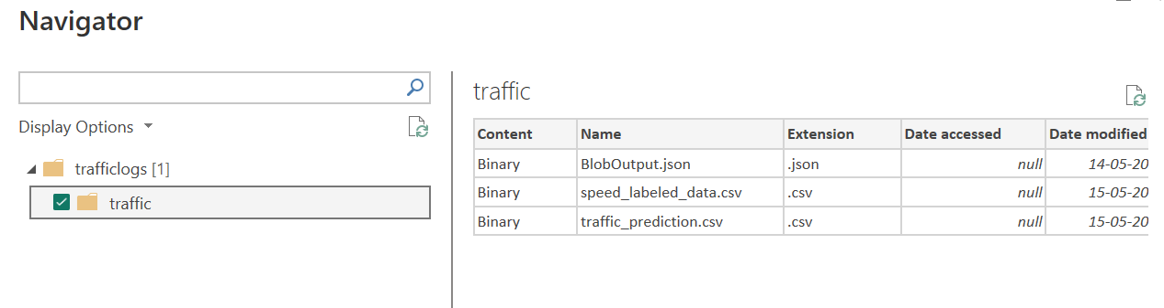
POWERBI CONNECTED WITH BLOB STORAGE:

Slide 16
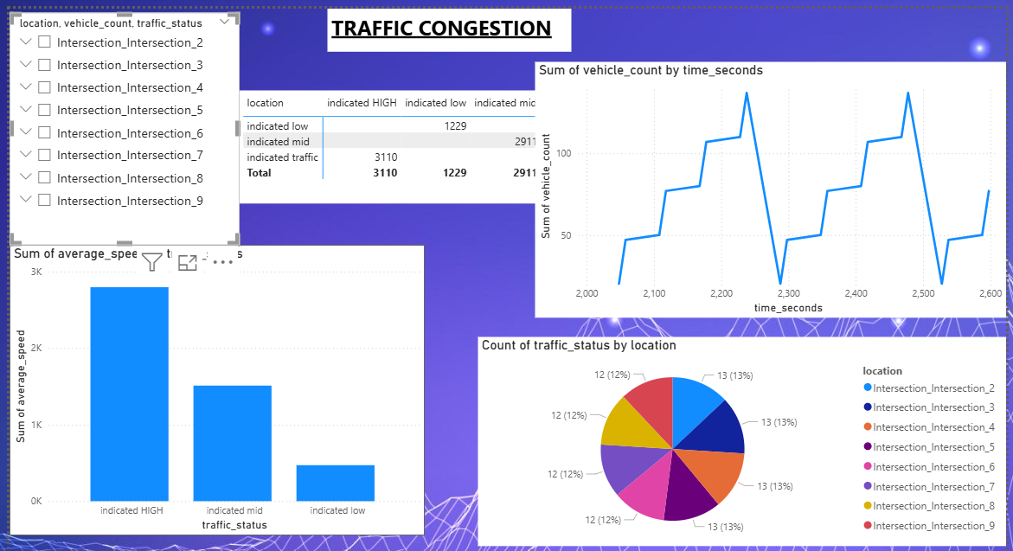
VISUALIZATION:

